Slide 1
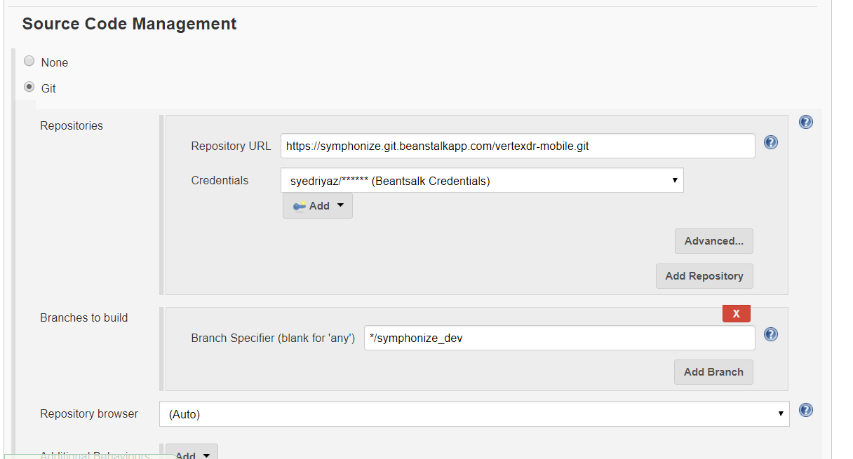

Slide 2
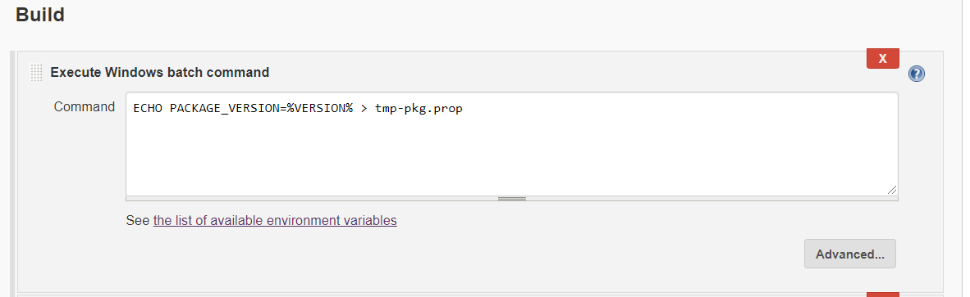

Slide 3
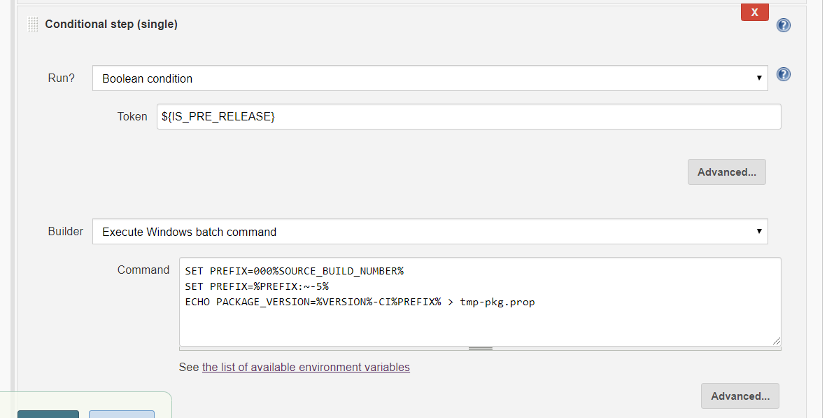

Slide 4
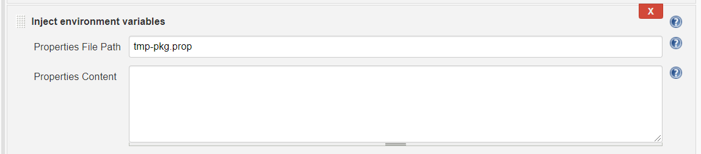

Slide 5
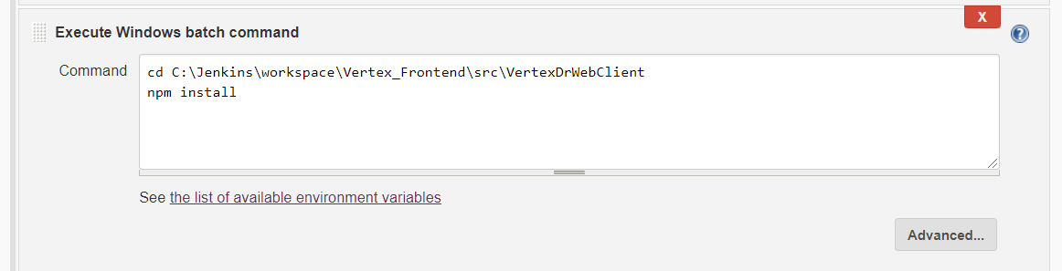

Slide 6
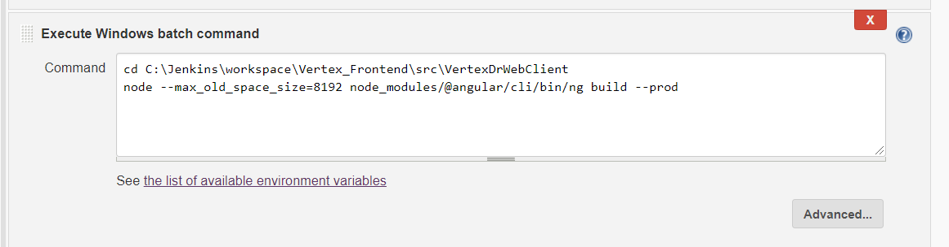

Slide 7
node --max_old_space_size=8192 node_modules/@angular/cli/bin/ng build --prod

Slide 8
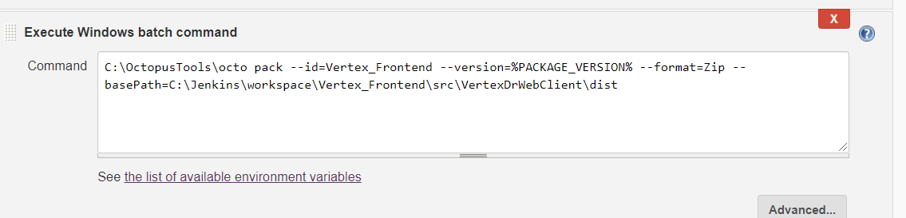

Slide 9
C:\OctopusTools\octo pack --id=Vertex_Frontend --version=%PACKAGE_VERSION% --format=Zip --basePath=C:\Jenkins\workspace\Vertex_Frontend\src\VertexDrWebClient\dist

Slide 10
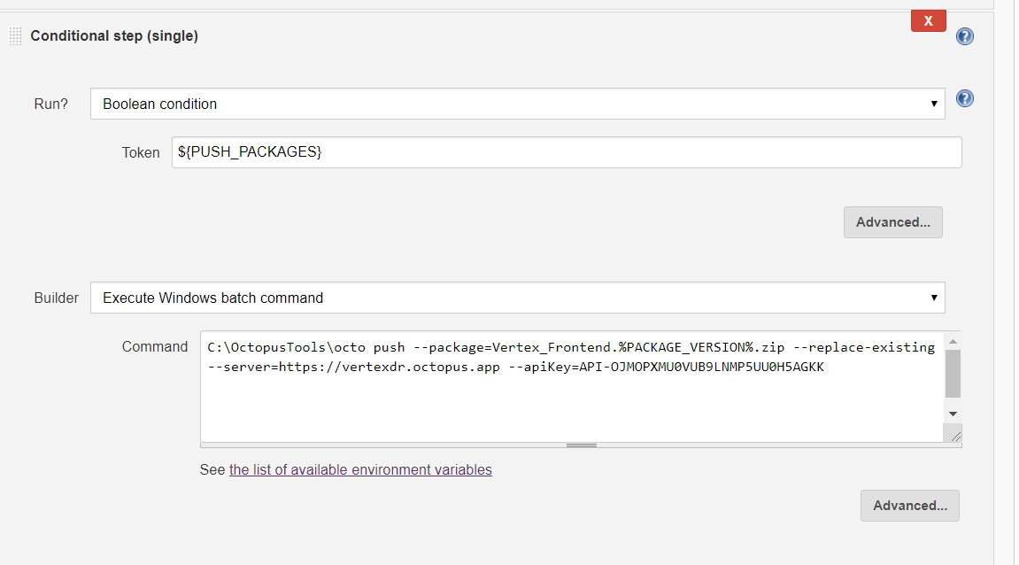

Slide 11
C:\OctopusTools\octo push --package=Vertex_Frontend.%PACKAGE_VERSION%.zip --replace-existing --server=https://vertexdr.octopus.app --apiKey=API-OJMOPXMU0VUB9LNMP5UU0H5AGKK

